Slide 1





BC Attaching Cricket Club (BATCC)
AGM 2025
http://batcc.de/

Slide 2


Agenda
SN | Agenda | Start | Duration
1 | Opening Words from the President - Zeeshan | 17:00 | 17:05
2 | BATCC Season 2025 - Team Structure - Ashish | 17:05 | 17:15
3 | BATCC Season 2025 - Club Strength - Ashish | 17:15 | 17:30
4 | Announcement SELCOM - 2025 Members - Ashish | 17:30 | 17:35
5 | Overview on Financials 2024 - Ashish | 17:35 | 18:00
6 | Performance Assessment 2024 - Survey & Team’s Overview | 18:00 | 18:30
7 | Training Plans & Volunteers to lead Training - Ranga | 18:30 | 18:45
8 | Elections - Youth Officer, Treasurer - Nitin, Zeeshan | 18:45 | 19:00

Slide 3
BATCC Season 2025 - Team Structure

Slide 4
BC Attaching Cricket
Key Drivers & Critical to Success
2025 Team Structure & Constellations
Less Members 42 v/s 62 in 2024.
Scenario_01: Probable
+------------------------------------------------------------------- +
| REGIONALLIGA [RL] |
| - Name to be Decided (TEAM-1) |
+-------------------------------------------------------------------+
| VERBANDSLIGA [VL] |
| - Name to be Decided (TEAM-2) |
+-------------------------------------------------------------------+
1 Strong Team v/s 1 Challenger Team, for both Scenarios. 4x Constellation for T-50s/T-40s & T-20s. Better Integration.
Scenario 2, won’t allow exchange of Players as 2x Teams would be in the same league group. Scenario 1 allows players movement.
+------------------------------------------------------------------- +
| REGIONALLIGA [RL] |
| - LIONS (BATCC-1) |
| - FALCONS (BATCC-2) |
+-------------------------------------------------------------------+
| VERBANDSLIGA [VL] |
| - WARRIORS (BATCC-3) |
+-------------------------------------------------------------------+
Managing Players would be easy as deemed relevant by Governing Body of BC Attaching Cricket.
2024
2025
+------------------------------------------------------------------- +
| REGIONALLIGA [RL] |
| - No Teams |
+-------------------------------------------------------------------+
| VERBANDSLIGA [VL] |
| - Name to be Decided (TEAM-1) |
| - Name to be Decided (TEAM-2) |
+-------------------------------------------------------------------+
New “SEL-COM” in place. Sanjeev Sivaraman, Rangarajan Varadan & Sasi Kiran Alur, with 2x Captains integrated.
Strong Team (Team-1) Captain decided “Vineep Bhat”, with “Amit Desai” as his deputy,
Challenger Team (Team-2) Captain yet to be decided.
Performing Players from 2024 “Falcons” and “Warriors” being transitioned to “Team-1”.
Scenario_02: Predominant
New Joiners in Team-2 to have a feel of the League and develop themselves into better players in 2025.

Slide 5
BC Attaching Cricket 2025
Department’s Demography

Slide 6
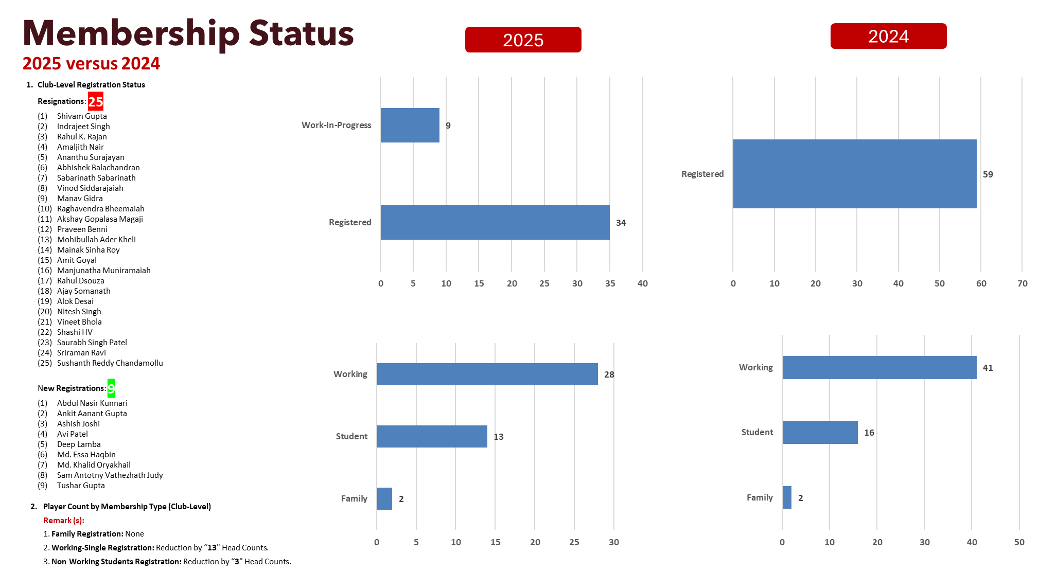

Slide 7
BC Attaching Cricket Members
Roles (By Members) | Count
BATTER | 10
BATTING_ALLROUNDER | 6
BOWLER | 11
BOWLING_ALLROUNDER | 10
WK-BATTER | 6
Grand Total | 43
Batters (Order-Wise vs Style) | Count
Lower-Middle-Order Batter | 13
Aggressive | 2
Anchors | 2
Power-Hitters | 1
Role-Players | 5
Tail-Ender | 3
Lower-Order Batter | 5
Anchors | 2
Power-Hitters | 1
Tail-Ender | 2
Middle-Order Batter | 17
Aggressive | 3
Anchors | 8
Consolidators | 4
Power-Hitters | 1
Role-Players | 1
Opening Batter | 4
Aggressive | 1
All-Rounder | 1
Consolidators | 2
Top-Order Batter | 4
Aggressive | 2
Consolidators | 2
Grand Total | 43
2025 | Member’s Demography | Overall & Batters
SI No | Player's Name | Role
1 | Abdul Nasir Kunari | BOWLER
2 | Abhijeesh Maroli | BOWLER
3 | Amit Rajendra Desai | BOWLER
4 | Ankit Gupta | WK-BATTER
5 | Apurva Sharma | BATTER
6 | Arjun Nadol | BATTER
7 | Ashish Joshi | BATTER
8 | Ashish Satpathy | WK-BATTER
9 | Avi Patel | BOWLING_ALLROUNDER
10 | Bhavin Kantilal Solanki | BOWLING_ALLROUNDER
11 | Deep Lamba | BOWLING_ALLROUNDER
12 | Deepak Kamal | BATTING_ALLROUNDER
13 | Dinesh Sasi Kumar | BOWLER
14 | Fahad Munawwar | BOWLER
15 | Haris Ali | BOWLING_ALLROUNDER
16 | Lakshmikanth Chippa | WK-BATTER
17 | Mohammad Essa Haqbin | BATTER
18 | Mohammad Khalid Oryakhail | WK-BATTER
19 | Mohammed Gouse Shaik | BOWLER
20 | Mohammed Shakir | BOWLING_ALLROUNDER
21 | Mohammed Yakub Ali | BATTER
22 | Moynul Hasan | BOWLER
23 | Muhammad Talha | BATTER
SI No | Player's Name | Role
24 | Muhammed Minhaj Madathodi | BOWLER
25 | Nitin Madan | BOWLER
26 | Paras Jain | BOWLING_ALLROUNDER
27 | Praveen Kumar Daneti | WK-BATTER
28 | Rajesh Kumar Srivastava | BATTING_ALLROUNDER
29 | Rangarajan Varadan | BATTER
30 | Rohit Verma | BOWLING_ALLROUNDER
31 | Sai Kiran Gundaboina | BATTING_ALLROUNDER
32 | Sam Antony Vathezhath Judy | BATTING_ALLROUNDER
33 | Sanjeev Sivaraman | WK-BATTER
34 | Sankara Muthukrishnan | BOWLING_ALLROUNDER
35 | Sasi Kiran Alur | BATTER
36 | Satya Prakash Sahoo | BOWLING_ALLROUNDER
37 | Shahroz Ismail | BOWLER
38 | Shashank Bhoskar | BOWLING_ALLROUNDER
39 | Shobhit Madan | BATTING_ALLROUNDER
40 | Tushar Gupta | BATTER
41 | Venkat Vinay Ayyagari | BOWLER
42 | Vineep Bhat | BATTING_ALLROUNDER
43 | Zeeshan Sami | BATTER
Batters (Left vs Right) | Count
Left-Handed Batter | 4
Right-Handed Batter | 39
Grand Total | 43
Batters (By Format) | Count
Longer Format (T-40s/T-50s) | 18
Multi-Format (T-50s, T-40s, T-20s) | 19
Shorter Format (T-20s) | 6
Grand Total | 43

Slide 8
BC Attaching Cricket Members
2025 | Member’s Demography | Bowlers
Bowlers (By Members) | Count
No | 11
Part-Time | 9
Yes | 23
Grand Total | 43
Bowlers (By Speed) | Count
Left-Arm Bowler | 2
Slow Bowler | 2
Right-Arm Bowler | 31
Fast Bowler | 2
Medium Bowler | 12
Medium-Fast Bowler | 13
Slow Bowler | 4
Grand Total | 33
Bowlers (By Format) | Count
Longer Format (T-40s/T-50s) | 12
Multi-Format (T-50s, T-40s, T-20s) | 18
Shorter Format (T-20s) | 3
Grand Total | 33
Bowlers (By Type) | Count
Express-Bowling | 1
Leg-Spin Bowling | 1
Off-Spin Bowling | 8
Part-Time Bowling | 2
Seam-Bowling | 10
Swing-Bowling | 11
Grand Total | 33
Bowler (By Overs) | Count
Containment Bowler | 7
Middle-Over Bowler | 14
Opening-Spell Bowler | 4
PowerPlay-Over Bowler | 6
Wicket-Taking Bowler | 2
Grand Total | 33
Bowlers (By Pitch Type) | Count
CocoPlanks-Pitch Bowler | 11
Permanent-Pitch Bowler | 6
Pitch-Agnostic Bowler | 16
Grand Total | 33

Slide 9
Announcement SELCOM - 2025 Members

Slide 10
SELCOM 2025 Members
Sanjeev Sivaraman
Rangarajan Varadan
Sasi Kiran Alur
2x Captains integrated (TBD)

Slide 11
Treasury Overview
Financials 2024
Planning 2025

Slide 12
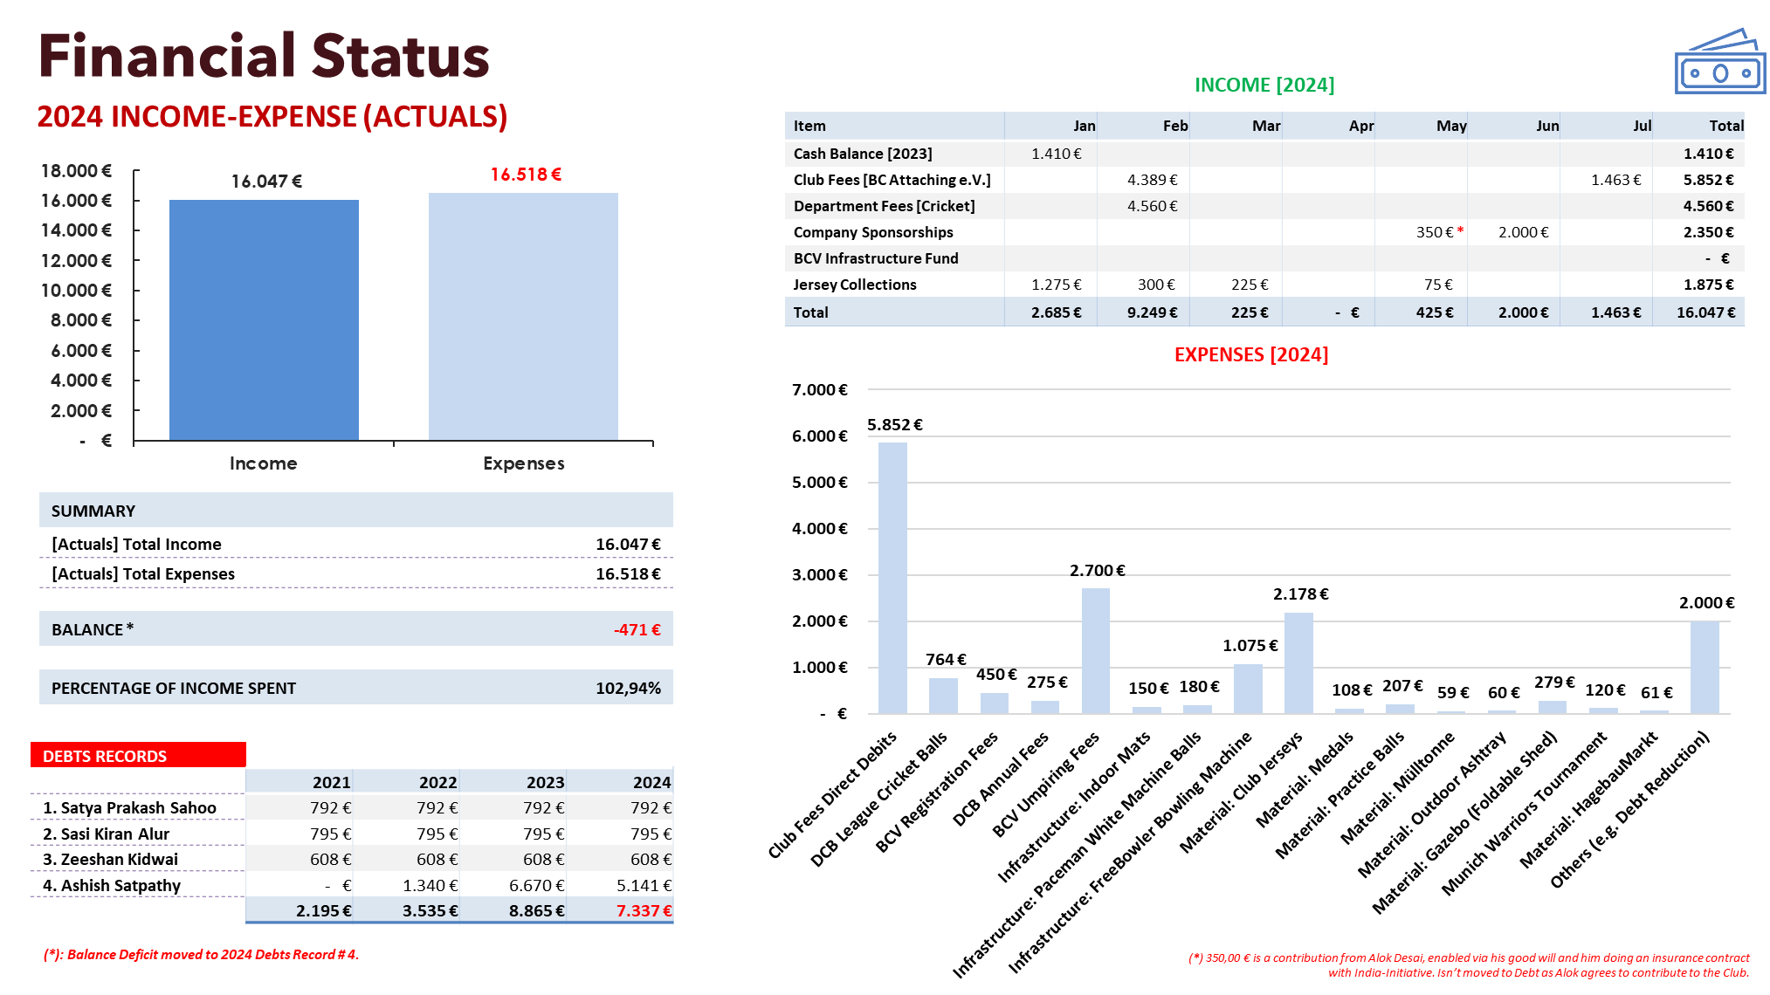

Slide 13
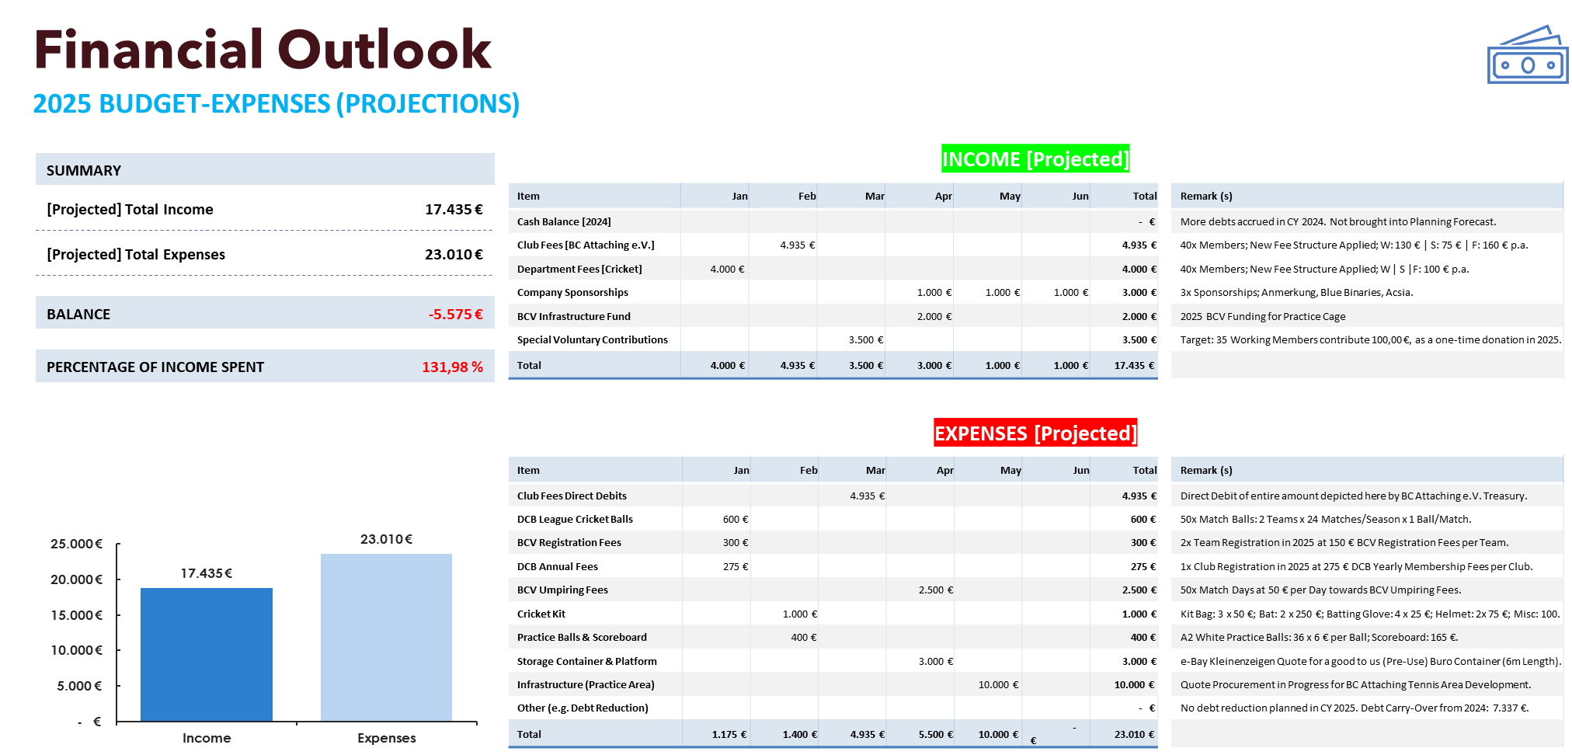
Tournament Wing:
BC Attaching Cricket (2025) plans to conduct 3-4 x Hard Tennis Ball and/or Leather Ball T-20 or T-10 Tournaments. 4 Weekend (s) of the Season 2025 would be reserved for the same. This would enable a Cash I/F to the tune of EUR 2.000 (NET).

Slide 14
Performance Assessment 2024

Slide 15
Survey Response Summary
Team Bonding and Individual Performances
New Talent Recruitment, improved Infrastructure, some inspiring performances
Improvement in Strategy (e.g. Focusing on bowling first )
No focused practice sessions
Poor team alignment and communication
Selection Issues (eg- Favoritism, inadequate roles for players)
Not enough chances or confidence
Overly defensive game strategies
Disorganisation in Management and decision-making

Slide 16
Survey Response Summary
Better preparation and planning for the next season:
Start team bonding and planning at least two months before the season.
More structured and purposeful practice sessions.
Early team selection to allow bonding.
Improvements in team structure:
Balanced teams with proper captains.
Equal opportunities and communication for all players.
Infrastructure changes:
Better outdoor practice areas.
Smaller, more efficient committees with clearer roles.
Cultural and mindset changes:
Foster positivity and belief in players.
Focus on finishing matches and improving mental toughness.

Slide 17
Warriors Report

Slide 18
Warriors Report
2024 | Verbandsliga (VL) | T40s & T20s
Shining Warriors: Haris, Arjun, Ashish J, Md. Essa.
Fighting Warriors: Paras, Shobhit, Abdul.
Pace Battery: Haris, Abdul, Shakir, Fahad and Moyn.
Team Camaraderie during the 2nd Half of the Season.
1x WINS in T-20 and T-40s against Moosburg. Few Close Matches against Passau and CCB.
Key Players making impact in other 2 RL Teams.
Broad plans for 2025
Team ceases to exist
Majority individuals play in VL-2025
Key Players move to 1x Strong VL or RL-Team for 2025
More LOSSES than WINS.
Batting & Fielding.
Absence of Key Players impacting important matches being lost.
Lack of Support from Seniors & Management for strengthening composition, guidance and motivating.

Slide 19
Lions Report

Slide 20
Lions Report
2024 | Regionaliga (RL) | T40s & T20s
Key Performers: Sasi, Essa, Zeeshan, Ashish, Amit, Satya, Vineep
Home wins
Winning attitude towards end
Broad plans for 2025
Team ceases to exist
Key Players move to 1x Strong VL or RL-Team for 2025
Key players missing throughout season
Losses in plenty, some very close matches
Batting, in general

Slide 21
Falcons Report

Slide 22
Falcons Report
vineep
2024 | Verbandsliga (RL) | T40s & T20s
Season started with some really close games but did not go in our favour.
2x50 in T50s & 1x50 in T20s
1x5 Wickets
Only one win throughout whole season including T50s and T20s.
Batting, Bowling & Fielding
Availability of the players for the matches.

Slide 23
Training Plans & Volunteers to lead Training

Slide 24

BATCC- Y&W-CoE
What is Needed:
Dedicated Y&W Officer
All members to Promote the Club to Women and Kids
Better outreach from BCV/DCB.
If Number of participants increases
Bigger Hall for Winter (5-15 €) per hour for 24-32 weeks
2 hours a week Total: 500-1000 €/Year
Equipment Budget as necessary
Dedicated Slots
10-12 Afghani + 1 Indian boy
Inauguration
Video + SoMe
1st Training
2 Women
Events
12.23
01.24
02.24
03.24
06.24
Time
Link

Slide 25


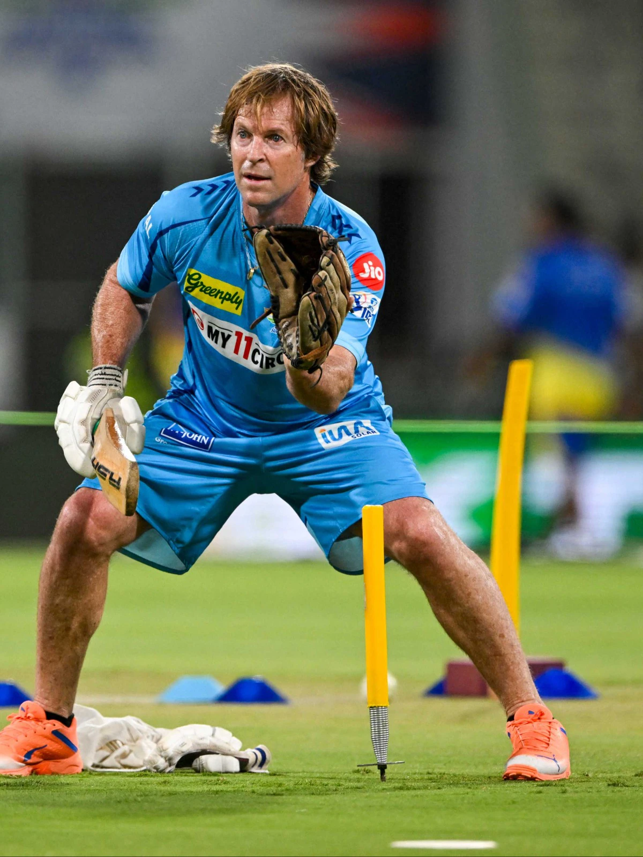
Training Plan
A separate
Batting ; Bowling; Fielding + Wicket Keeping Camp (2 Weeks each) (6 Weeks)
Combined Workshop/Practice (Outdoor) or a Bigger Hall for a week or two.
Phase 1
Phase 2
Experiment | Observe | Infer | Improve
Practice Matches against BL or Strong RL Team
Phase 3
Observe | Infer | Improve
Season/Matches
Phase 4
Observe | Infer | Improve
T20 Specific Training

Slide 26
Forming a Training ‘Committee’ or Group
Expectations
Plan the Training
Understand Experiment Observe Infer Improve
Run Drills and Execute.
Plan amongst Training Committee
Players Participate Uninfluenced
Captain Vice Captain and one Stand-in are the ones who know the details and simply execute the plan.
They’re are also the ones who Observe Infer and Improve

Slide 27
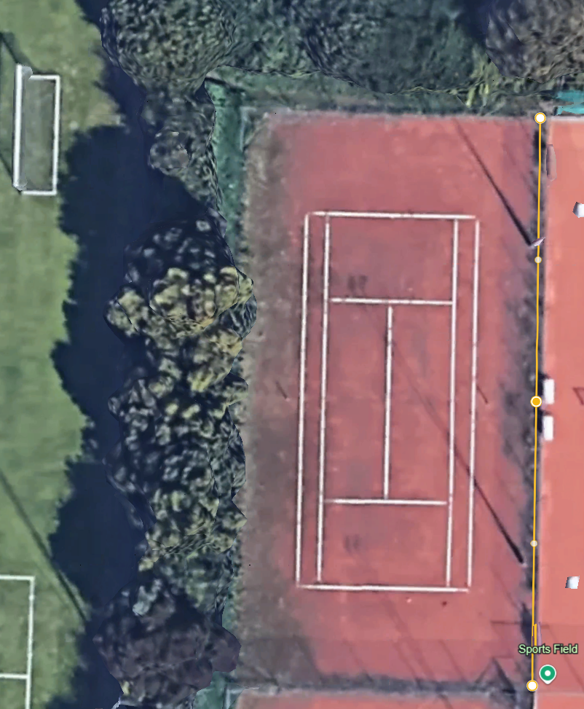
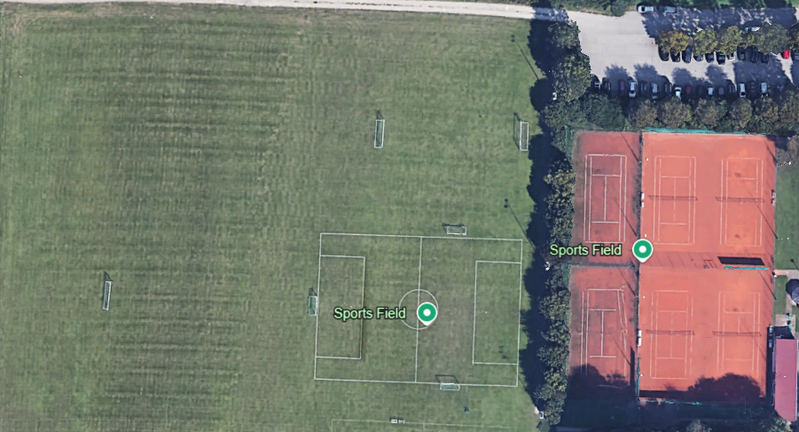
Project Location
Standort des Projekts
Dies ist ein unbenutzter „Tennisplatz“ beim BC Attaching e.V., Am Sportplatz 3, 85356 Freising.
Die Größe des Tennisplatzes ist: L (36m) x B (18m).
Der Tennisplatz ist an 4 Seiten mit Stahlkäfigen umgeben, wie auf dem Bild zu sehen.

Slide 28
Sketch Map
Skizze Kart
Aktive Tennisplätze
36 m
Parken Seite
Beach-Volleyballplatz
Tennis Court
18 m
Kricketplatz

Slide 29
Kricket-Übungsplatz
6 m
6 m
Gabionen
Gabionen
Gabionen
Gabionen
Rasen
Betonpflastersteine
Betonpflastersteine
Rasen
Übungsplatz 1
Übungsplatz 2
15 m
Oben sollte auch Gabionen sein.
Kricketplatz

Slide 30
Zusätzliche Vorarbeiten:
Es würden zusätzliche Vorbereitungsarbeiten anfallen, wie zum Beispiel, aber nicht ausschließlich:
Reinigung des Tennisplatzes (Lehm) und Nivellierung mit Erde oder geeigneten Materialien.
2. Entfernung der bestehenden Metallzäune (36 m) auf der Seite des Cricketplatzes. Die entfernten Metallzäune können wiederverwendet werden, um die „Gabionen“ auf den 2 geplanten Cricket-Übungsplätzen anzulegen.
Entfernung der Bäume und des Bodens auf der Cricket Ground Seite des Tennisplatzes und Nivellierung desselben und Anlegen von Gras darauf. Für die Entsorgung des abgetragenen Bodens muss eine Lösung gefunden werden.
Anlegen von Spazierwegen in dem mit Gras bewachsenen Bereich an der Seite des Tennisplatzes usw.
Schaffung von Stromanschlüssen in der Nähe des Cricket-Übungsplatzes.

Slide 31
Elections

Slide 32
Format
We planned to conduct elections for two open positions
Treasurer and Youth Officer.
For Youth Officer, we have no nominations so far.
We have 2 nominations for the position of Treasurer - Ankit Gupta and Ranga
We would request each of the nominees to introduce themselves, and justify how they are suited for the role
Ranga:
Treasurer at Badminton Club for 3 years.
Key Goals for BATCC:
Get out of the present Debt.
Promote Sponsorship with Perks Concept.
Positive/Meaningful Investments
Tennis Ball Tournaments for Revenue generation.
Box Cricket.
Memberships for Kids and Women and (intra club & New)
Kids/Women groups from other club’s Partnerships.
Ankit:
Was Trainer & Treasurer at SGMCC, Moosburg for over 4 Years.
SGM overall positive net balance of 8k euros.
Implemented best practices:
cost control, meaningful investments,
revenue creation via tournaments, ground rents and sponsorships also at BC Attaching.

Slide 33

Thank you
Wish you all success in 2025

Slide 34
Plans for 2025
High level summary is presented only
Elected members to prepare a detail plan in present in January 2024
Winter halls on Saturday evening and Sunday morning
Winterliga may happen in Jan 2024 – structure not known yet
We will limit to max 54 members in the club
3 teams in summer league
  Lions and Falcons in RL, Warriors in VL
  T20 league format is not known yet, but will be a league structure
Women and Youth important, we may get nominated as youth center of excellence
Summer practice – Monday, Friday evening
Summer matches – Sunday + Few Saturdays
We need sponsors!
We need club bonding activities!

Slide 35
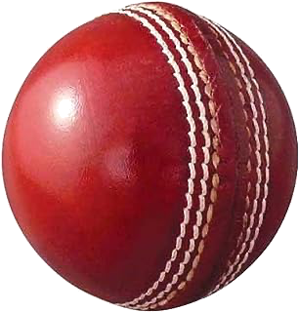
Club Governing Body
Treasurer
Yesh
Social Media & Recruitment
Vineet Bhola
Secretary
Nitin
Captain – Warriors
Mohammed Ali
President
Zeeshan
Youth & Women
- Sai & Ranga
Captain – Falcons
Rohit Verma
1 Rep from SelCom
Sanjeev
Captain – Lions
Satya
Election Sequence: President – Treasurer – Secretary - Social Media – Youth/Women

Slide 36
Plans for 2025
http://batcc.de/

